Slide 1


Slide 2

Machine Learning Credit Hours: (2+1)
Presenter
Ms. Qurat-ul-Ain Raja

Slide 3
Regression

Slide 4
Regression
Linear Regression is an algorithm that belongs to supervised Machine Learning. It tries to apply relations that will predict the outcome of an event based on the independent variable data points.
The relation is usually a straight line that best fits the different data points as close as possible. The output is of a continuous form, i.e., numerical value.
For example, the output could be revenue or sales in currency, the number of products sold, etc. In the above example, the independent variable can be single or multiple.
In Machine Learning, and in statistical modeling, that relationship is used to predict the outcome of future events.
Simple Linear Regression
Multiple linear regression
Logistic regression

Slide 5
Linear regression
Since the Linear Regression algorithm represents a linear relationship between a dependent (y) and one or more independent (y) variables, it is known as Linear Regression.
This means it finds how the value of the dependent variable changes according to the change in the value of the independent variable.
The relation between independent and dependent variables is a straight line with a slope.

Slide 6
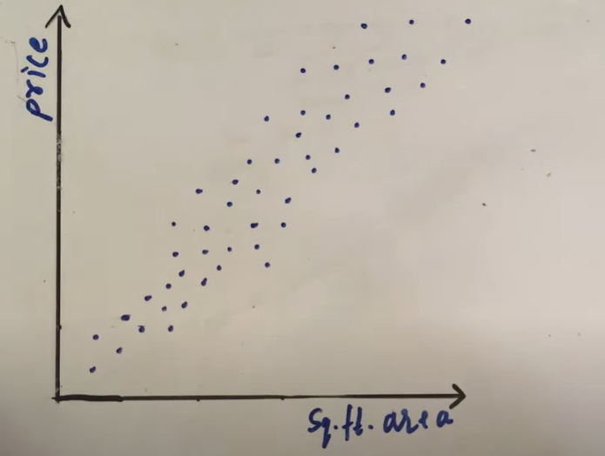

Slide 7
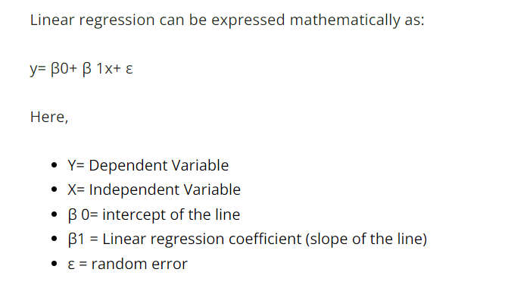

Slide 8
Simple Linear Regression
This is one of the most common and interesting type of Regression technique. Here we predict a target variable Y based on the input variable X. A linear relationship should exist between target variable and predictor and so comes the name Linear Regression.
A simple straight-line equation involving slope (dy/dx) and intercept (an integer/continuous value) is utilized in simple Linear Regression. Here a simple form is:
y=mx+c where y denotes the output x is the independent variable, and c is the intercept when x=0. With this equation, the algorithm trains the model of machine learning and gives the most accurate output

Slide 9
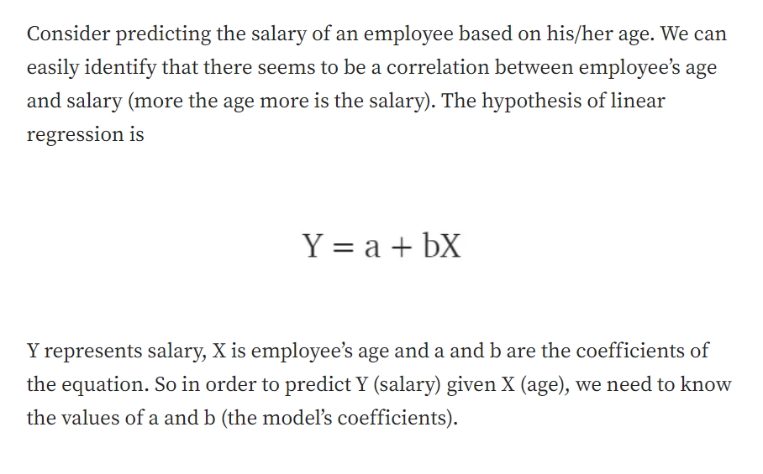
Y=mx+c

Slide 10
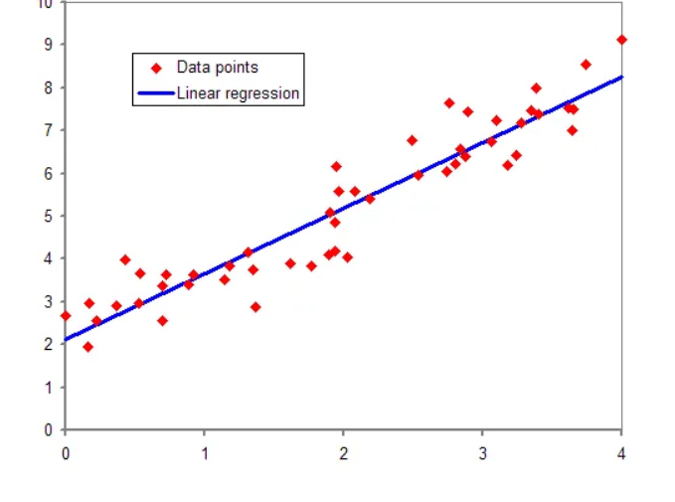
In the figure, the red points are the data points and the blue line is the predicted line for the training data. To get the predicted value, these data points are projected on to the line.

Slide 11
Multiple Linear Regression
When a number of independent variables more than one, the governing linear equation applicable to regression takes a different form like:
y= c+m1x1+m2x2… mnxn where represents the coefficient responsible for impact of different independent variables x1, x2 etc. This machine learning algorithm, when applied, finds the values of coefficients m1, m2, etc., and gives the best fitting line.

Slide 12
Example
Let's consider a dataset of students' hours of study (X) and their corresponding exam scores (Y). We want to create a linear regression model to predict exam scores based on the number of hours studied.
Hours of Study (X) | Exam Score (Y)
2 | 70
3 | 80
4 | 85
5 | 90
6 | 95

Slide 13
Calculating Line of Linear Regression
Y=c+mx
M=slope
C=intercept
y = b0 + b1x
b1=slope
b0=intercept

Slide 14
Calculate Slope
m = Σ((Xi - X̄) * (Yi - Ȳ)) / ΣΣ((Xi - X̄)^2)
OR
b1 = Σ((Xi - X̄) * (Yi - Ȳ)) / ΣΣ((Xi - X̄)^2)
For slop, calculate means

Slide 15
Calculate Intercept
b0 = Ȳ - b1 * X̄
Y=MX+C
C=Y-MX

Slide 16
Step 1: Calculate the Mean
Calculate the mean of X and Y.
- Mean of X (X̄) = (2 + 3 + 4 + 5 + 6) / 5 = 4
- Mean of Y (Ȳ) = (70 + 80 + 85 + 90 + 95) / 5 = 84
Step 2: Calculate the Slope (b1)
Calculate b1 using the formula: b1 = Σ((Xi - X̄) * (Yi - Ȳ)) / ΣΣ((Xi - X̄)^2)
b1 = ((2 - 4) * (70 - 84) + (3 - 4) * (80 - 84) + (4 - 4) * (85 - 84) + (5 - 4) * (90 - 84) + (6 - 4) * (95 - 84)) / ((2 - 4)^2 + (3 - 4)^2 + (4 - 4)^2 + (5 - 4)^2 + (6 - 4)^2)
Calculate the numerator and denominator separately, then divide to find b1.

Slide 17
Step 3: Calculate the Intercept (b0)*3.
Calculate b0 using the formula: b0 = Ȳ - b1 * X̄
- Plug in the values: b0 = 84 - b1 * 4
Step 4: Formulate the Linear Regression Equation*4.
Now that you have found b0 and b1, you can formulate the linear regression equation:
Y = b0 + b1 * X
Substituting the values: Y = (84 - b1 * 4) + b1 * X
Step 5: Using the Equation*5.
With the equation Y = 84 - b1 * 4 + b1 * X, you can now predict exam scores (Y) based on the number of hours of study (X).

Slide 18
Uses
Forecasting continuous outcomes like house prices, stock prices, or sales.
Predicting the success of future retail sales or marketing campaigns to ensure resources are used effectively.
Predicting customer or user trends, such as on streaming services or e-commerce websites.
Analysing datasets to establish the relationships between variables and an output.
Predicting interest rates or stock prices from a variety of factors.
Creating time series visualisations.

Slide 19
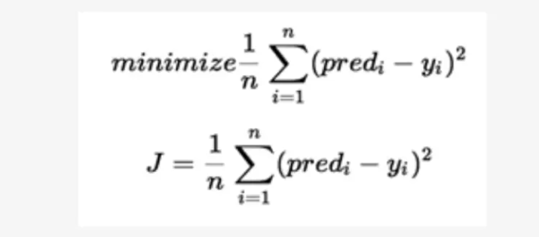
Cost Function
Cost function measures the performance of a machine learning model for a data set. Cost function quantifies the error between predicted and expected values and presents that error in the form of a single real number.

Slide 20
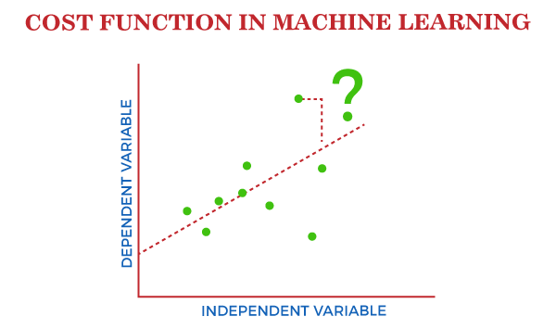

Slide 21
Thank You!

